Slide 1
An Inside Overview of Key Regulations that Keep Healthcare Leaders Up at Night
Taya Moheiser, MBA, CMPE, CMOM
Sr. Advisor, eobee (H4 Technology)

Slide 2
Overview
This session will cover:
CMS Final Physician Fee Schedule Rule for 2022
The Impact of the PAYGO Rule
Surprise Billing Rule (CAA)
OIG Workplan Updates
OCR Settlements & HIPAA Right of Access Initiative
OSHA Emergency Temporary Standard

Slide 3
Proposed Rule vs Final Rule
An important distinction
Proposed rules are issued by CMS and other federal/state bodies to let you know what they are planning to do in the upcoming term.
Every Year CMS issues a host of proposed rules impacting providers, hospitals, and administrative staff across the industry.
Those interested in responding have 60 days to do so before CMS evaluates the responses and makes a final decision.
Once the final rule has been released for the upcoming term, no further comments to that rule are considered.
CMS has over
251 Million insured lives
and
1.4 Million participating providers

Slide 4
Medicare Physician Payment and Quality Reporting Changes 2022
Proposed Rule Released
Comments Welcome
CMS Review and Finalization
Final Rule Release
This is our focus for today’s session
On 7/13/2021
Thru 9/13/2021
Nov. 2021

Slide 5
CMS Physician Fee Schedule CY 2022
Notes:
This section of the presentation covers the changes that were finalized by the Centers for Medicare and Medicaid for the 2022 calendar year.
This will be referred to as the CMS PFS, or CY2022 PFS henceforth.

Slide 6
Telehealth Category 3 Codes
Regarding temporary additions to Category 3 codes made during the Public Health Emergency (PHE):
CMS has agreed to retain all services added to the Medicare telehealth services list on a Category 3 basis until the end of CY 2023
Additionally, CMS is adding:
CPT 93797 (Cardiac Rehab) and CPT 93798 (Cardiac Rehab/Monitor)
HCPCS G0422 (Intense Cardiac Rehab w/ Exercise) and HCPCS G0423 (Intense Cardiac Rehab w/o Exercise)

Slide 7
Telehealth Mental Health
The Consolidation Appropriations Act of 2021 made changes which were recognized and implemented by the CMS CY2022 PFS including:
Allowing the patient’s home as a permissible originating site, for telehealth services furnished to a patient with a diagnosed substance use disorder (SUD) for treatment of that disorder or a co-occurring mental health disorder
There must be an in-person non-telehealth visit within six months of the initial telehealth visit and a cadence of regular in-person visits will be set by the secretary for subsequent patient services
In addition, there must be an in-person visit every 12-months with few exceptions

Slide 8
Telehealth Mental Health
CMS also clarified in the final rule:
The patient’s home may include temporary lodging, such as hotels and homeless shelters
Additionally, if the patient, for privacy or other personal reasons, chooses to travel a short distance from the exact home location during a telehealth service, the service is still considered to be furnished “in the home”
Rural Emergency Hospitals will now qualify as an originating site for telehealth services

Slide 9
Audio-Only Communication
CMS has finalized audio-only communications technology after the expiration of the PHE when used for telehealth services for the diagnosis, evaluation, or treatment of mental health disorders furnished to established patients when the originating site is the patient’s home
All other telehealth requirements continue to apply (i.e. initiating visit w/in 6 months & at least every 12-months thereafter)
In addition, the provider must have audio/visual telecommunications capabilities and it must either be the patient’s desire or inability to access video which necessitates the audio-only visit.
A service-level modifier will be required to indicate the audio-only nature of these visits. (Modifier -93)
Link to CMS Telehealth Modifier Fact Sheet
https://www.ama-assn.org/practice-management/cpt/cpt-appendix-t-and-modifier-93-audio-only-medical-services#:~:text=At%20its%20September%202021%20meeting,patient%20through%20audio%2Donly%20technology

Slide 10
Virtual Check-Ins & Fee Updates
CMS finalized separate coding for longer virtual check-in codes with HCPCS Code G2252 (crosswalk to 99442 for valuation)
Synchronous communication required
Audio-only communication permitted
The purpose of this service is to determine if an in-person patient visit is warranted
Telehealth Originating Site Fee Update
For CY 2022, the payment amount for HCPCS code Q3014 (Telehealth originating site facility fee) is $27.59.
An increase of 2.1% over CY 2021 which came to $27.02

Slide 11
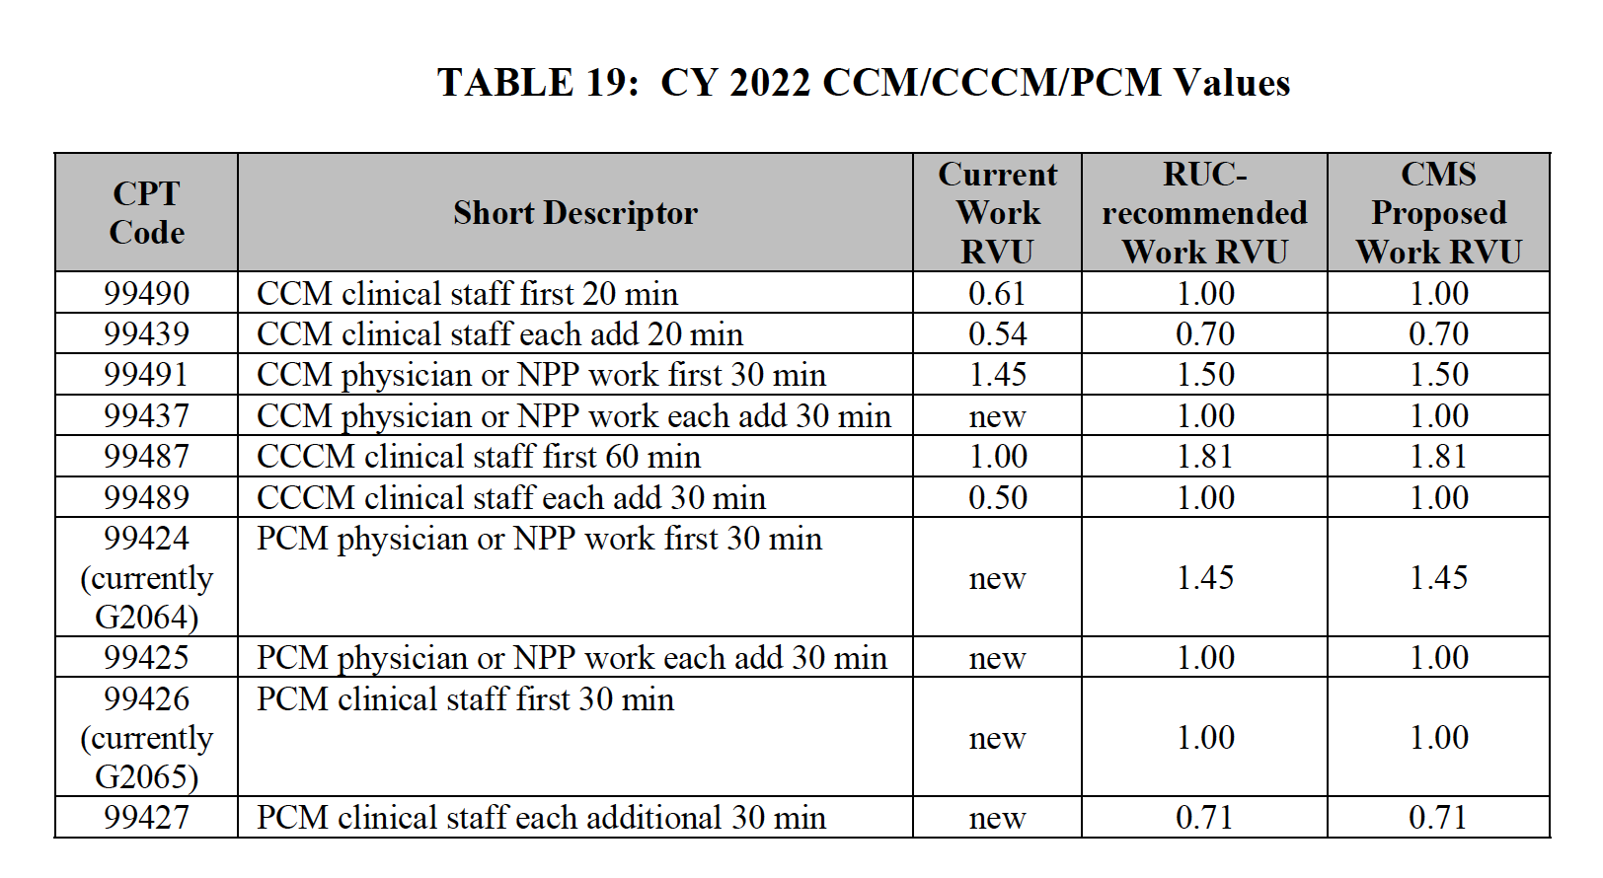
Four New Codes
Notes:
RUC is the RVU Update Committee

Slide 12
Split (or Shared) Visits
CMS made clarifications to split visits to include in this definition:
Visits that are furnished in a facility setting by a physician and an NPP in the same group, where the facility setting is defined as an institutional setting in which payment for services and supplies furnished incident to a physician or practitioner’s professional services is prohibited
An E/M visit could be billed by either the physician or the NPP if it were furnished independently by only one of them in the facility setting

Slide 13
Split (or Shared) Visits
CMS also made adjustments to allow physicians and NPPs to bill for split (or shared) visits for both new and established patients, and for critical care and certain Skilled Nursing Facility /Nursing Facility (SNF/NF) E/M visits
NPPs may bill for split (or shared) visits for both new and established patients, as well as for initial and subsequent visits
The changes made to split/shared visits will be codified in § 415.140

Slide 14
Split (or Shared) Visits
The physician or NPP who performs the substantive portion of the split (or shared) visit would bill for the visit:
Substantive portion is defined as more than half of the total time spent by the physician and NPP performing the split (or shared) visit
For CY 2022, the practitioner who spends more than half of the total time, or performs the history, exam, or MDM can be considered to have performed the substantive portion and can bill for the split (or shared) E/M visit.
Providers can still use MDM to select visit level for the E/M split (or shared) visit, as proposed.
When one of the three key components is used as the substantive portion in 2022, the practitioner who bills the visit must perform that component in its entirety in order to bill
For visits that are already timed (critical care services), the substantive portion will not be based on performance of the history, exam, or MDM. For critical care visits the substantive portion will be more than half of the total time

Slide 15
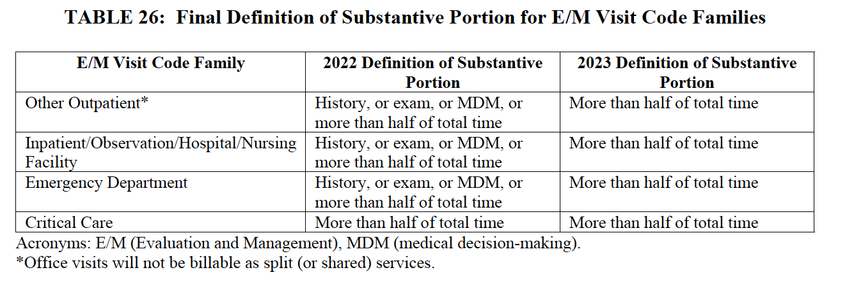
Split (or Shared) Visits
The following chart from CMS explains the 2022 definition and the 2023 definition of “Substantive Portion” for billing purposes
The distinct time of service spent by each physician or NPP furnishing a split (or shared) visit would be summed to determine total time and who provided the substantive portion (and therefore, bills for the visit)

Slide 16
Split (or Shared) Services
For visits that are not critical care services, this listing of activities count when time is used to select an E/M visit level when performed. Regardless of whether or not they involve direct patient contact:
Preparing to see the patient (for example, review of tests).
Obtaining and/or reviewing separately obtained history.
Performing a medically appropriate examination and/or evaluation.
Counseling and educating the patient/family/caregiver.
Ordering medications, tests, or procedures.
Referring and communicating with other health care professionals (when not separately reported).
Documenting clinical information in the electronic or other health record.
Independently interpreting results (not separately reported) and communicating results to the patient/ family/caregiver.
Care coordination (not separately reported).
Practitioners would not count time spent on the following:
The performance of other services that are reported separately.
Travel.
Teaching that is general and not limited to discussion that is required for the management of a specific patient

Slide 17
Split (or Shared) Visits
For all split (or shared) visits, one of the practitioners must have face-to-face (in-person) contact with the patient, but it does not necessarily have to be the physician, nor the practitioner who performs the substantive portion and bills for the visit.
The substantive portion could be entirely with or without direct patient contact and will be determined by the proportion of total time, not whether the time involves direct or in-person patient contact.

Slide 18
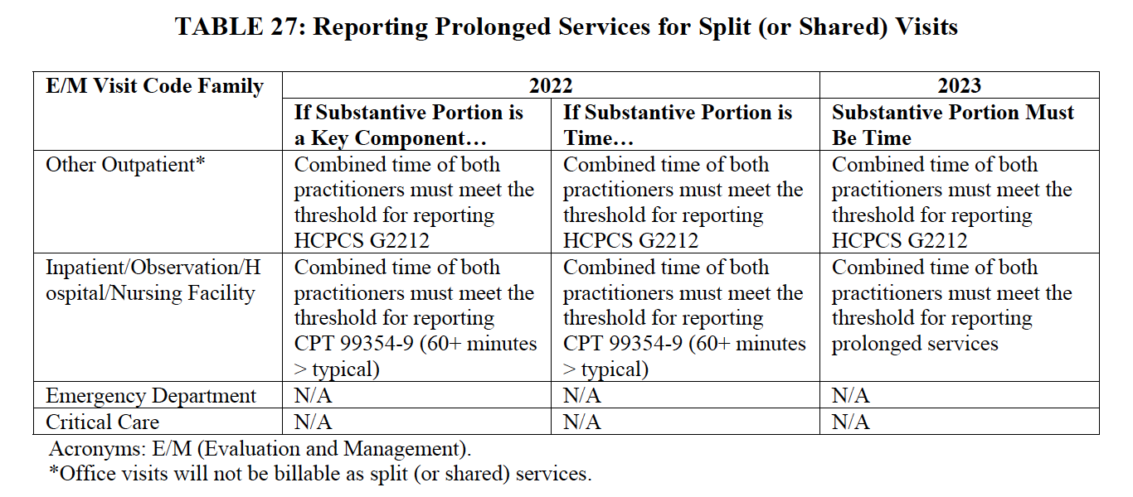
Split (or Shared) Visits
For all other types of E/M visits (except ED and critical care visits), prolonged services can be reported by the practitioner who reports the primary service, when the combined time of both practitioners meets the threshold for reporting prolonged E/M services other than office/ outpatient E/M visits (60 or more minutes beyond the typical time in the CPT code descriptor of the primary service)

Slide 19
Key Takeaways
The 2022 rules for Split/Shared Visits are different than the rules for 2023
NPPs may bill for split (or shared) visits for both new and established patients, as well as for initial and subsequent visits
A modifier will be required to identify these services
Documentation must identify the two individuals who performed the visit and the individual providing the substantive portion must sign and date the medical record
The two individuals must be in the same group

Slide 20
Critical Care Redefined
CMS Redefined Critical Care as follows:
“Critical care is the direct delivery by a physician(s) or other qualified healthcare professional (QHP) of medical care for a critically ill/injured patient in which there is acute impairment of one or more vital organ systems, such that there is a probability of imminent or life-threatening deterioration of the patient’s condition.
It involves high complexity decision-making to treat single or multiple vital organ system failure and/or to prevent further life-threatening deterioration of the patient’s condition.”
(p450 CMS CY2022 PFS)

Slide 21
Critical Care Billing Codes
99291 for the first 30-74 minutes of critical care services provided to a patient on a given date
99292 for additional 30-minute time increments provided to the same patient
This should account for the total time spent, aggregated, on critical care services for the patient even if these services were not continuous on that date

Slide 22
Physician Assistant Billing
PAs will be authorized to bill the Medicare program and be paid directly for their services in the same way that NPs and CNSs do effective 1/1/2022
PAs also may reassign their rights to payment for their services
PAs may choose to incorporate as a group comprised solely of practitioners in their specialty and bill the Medicare program

Slide 23
Therapy Services
The Bipartisan Budget Act of 2018 (BBA)requires that CMS reduce payment for physical therapy (PT) and occupational therapy (OT) services furnished in whole or in part by PTAs and OTAs at 85 percent of the otherwise applicable Part B payment for the service, effective January 1, 2022:
CQ modifier: Physical therapy services furnished in whole or in part by PTAs.
CO modifier: Occupational therapy services furnished in whole or in part by OTAs
A service is considered to be furnished in whole or in part by a PTA or OTA when more than 10 percent of the service is furnished by the PTA or OTA.
Note: CMS did not finalize their earlier proposed new documentation requirements for OTAs and PTAs

Slide 24
Colorectal Cancer Screening
Effective 1/1/22, when a planned colorectal cancer screening test, that is, screening flexible sigmoidoscopy or screening colonoscopy test, requires a related procedure, including removal of tissue or other matter, furnished in connection with, as a result of, and in the same clinical encounter as the screening test, it is considered to be a colorectal cancer screening test.
An increase to Medicare payment percentage (thereby creating a coinsurance reduction) will be phased in over time.
80% payment percentage for 2022 (20% coinsurance)
85% payment percentage for 2023 – 2026 (15% coinsurance)
90% payment percentage for 2027 – 2029 (10% coinsurance)
100% payment percentage for services furnished in 2030 onward

Slide 25
Vaccine Administration Payment
Beginning for services furnished in CY 2022, CMS has finalized a uniform payment rate of $30 for the administration of an influenza, pneumococcal or HBV vaccine covered under the Medicare Part B preventive vaccine benefit
CMS will maintain the current payment rate of $40 per dose for the administration of the COVID-19 vaccines through the end of the calendar year in which the PHE ends
January 1 of the year after the PHE expires, administration of the COVID-19 vaccine will align with the other preventive services vaccinations

Slide 26
Vaccine Administration at Home
CMS introduced an add-on payment with a national rate of $35.50 when a COVID-19 vaccine is administered in the home
HCPCS code M0201 (COVID-19 vaccine administration inside a patient’s home; reported only once per individual home per date of service when only COVID-19 vaccine administration is performed at the patient’s home)
should be billed alongside an eligible vaccination administration code (0001A, 0002A, 0011A, 0012A, 0031A)
This will only be applicable in the following circumstances:
(1) The patient has a condition, due to an illness or injury, that restricts their ability to leave home without a supportive device or help from a paid or unpaid caregiver; or
(2) The patient has a condition that makes them more susceptible to contracting a pandemic disease like COVID-19; or
(3) The patient is generally unable to leave the home, and if they do leave home, it requires a considerable and taxing effort; and
The patient is hard-to-reach because they have a disability or face clinical, socioeconomic, or geographical barriers to getting a COVID-19 vaccine in settings other than their home

Slide 27
Vaccine Administration At Home
This code could be billed only once per individual home per date of service
More than one beneficiary in the same home does not qualify for additional administration code billing with the only exception being the administration of COVID-19 vaccines
This does not apply to the following facility settings: communal spaces of a multi-unit living arrangement; hospitals; Medicare SNFs, and Medicaid NFs, or assisted living facilities participating in the CDC’s Pharmacy Partnership for Long-Term Care Program when their residents are vaccinated through this program
An institution is not considered to be a patient's home if the institution meets the requirements of sections 1861(e)(1), 1819(a)(1), or 1919(a)(1) of the Act, which includes hospitals and skilled nursing facilities (SNFs), as well as most nursing facilities under Medicaid

Slide 28
Monoclonal Antibody Therapeutic Services
CMS will continue to pay for COVID-19 monoclonal antibody therapeutic products as vaccines until the end of the year in which the PHE expires
During this interim time, CMS will continue to pay providers and suppliers for the products themselves at 95 percent of Average Wholesale Price (AWP) except when they are provided for free by the government;
CMS will also maintain the $450 payment rate for administering a COVID-19 monoclonal antibody in a healthcare setting, as well as the payment rate of $750 for administering a COVID-19 monoclonal antibody therapy in the home
January 1 of the year after the PHE expires, CMS will treat COVID-19 monoclonal antibody therapies as biologics and discontinue the unique payment rates of $450 and $750 for administering a COVID-19 monoclonal antibody product

Slide 29
Summary of Vaccine Administration Reimbursement

Slide 30
Rural Health Centers (RHCs)
For provider-based RHCs that meet certain requirements but did not have a per visit payment amount (or AIR) established for services furnished in 2020, the payment limit per visit shall be at an amount equal to the greater of:
(1) the per visit payment amount applicable to the provider-based RHC for services furnished in 2021; or
(2) the national statutory payment limit for RHCs.
In a subsequent year (that is, after 2022), the provider-based RHCs payment limit per visit will be the greater of:
(1) the payment limit per visit established for the previous year, increased by the percentage increase in MEI applicable to primary care services furnished as of the first day of such subsequent year; or
(2) the national statutory payment limit for RHCs.

Slide 31
RHC Temporary Locations
RHCs that established temporary locations during the PHE were permitted to enroll and receive temporary Medicare billing privileges.
When the PHE for COVID-19 ends, an RHC that was temporarily enrolled under the must submit a complete CMS-855 enrollment application in order to establish full Medicare billing privileges.
Failure to do so will result in the deactivation of the RHC’s temporary billing privileges.
No payments can be made for services provided while the temporary billing privileges are deactivated

Slide 32
FQHCs, RHCs: Hospice
On or after January 1, 2022, when a designated attending physician employed by or working under contract with an FQHC or RHC furnishes hospice attending physician services, the FQHC or RHC is eligible to receive payment under the FQHC PPS or RHC AIR, respectively.
When the RHC/FQHC furnishes a hospice attending physician service that has a TC, the provider furnishing the TC would go to the hospice for payment.

Slide 33
FQHCs & RHCs: CCM & TCM
CMS will allow RHCs and FQHCs to bill for TCM and other care management services furnished for the same beneficiary during the same service period, provided that all requirements for billing each code are met
This includes the services described by HCPCS codes G0511 (General Care Management for RHCs and FQHCs only) and G0512 (Psychiatric CoCM code for RHCs and FQHCs only), which both describe a service period of one calendar month
Time and effort cannot be counted more than once.

Slide 34
FQHCs & RHCs: Telehealth
The temporary authority to pay RHCs and FQHCs for furnishing distant site Medicare telehealth services expires when the PHE for the COVID-19 pandemic is terminated.
At this time, the payment mechanism for the professional services of RHC and FQHC practitioners will be FQHC and RHC payments under the established methodology, that is the RHC AIR or the FQHC PPS.
CMS revises the regulatory requirement for mental health encounters to include encounters furnished through interactive, real-time telecommunications technology, but only when furnishing services for the purposes of diagnosis, evaluation, or treatment of a mental health disorder.
They will also allow RHCs and FQHCs to furnish mental health visits using audio-only interactions in cases where beneficiaries were not capable of, or did not consent to, the use of devices that would permit a two-way, audio/video interaction
There must be an in-person mental health service furnished within 6 months prior to the furnishing of the telecommunications service
There must also be an in-person mental health service (without the use of telecommunications technology) must be provided at least every 12 months while the beneficiary is receiving services furnished via telecommunications technology for diagnosis, evaluation, or treatment of mental health disorders. There are limited exceptions to the 12-month requirements.

Slide 35
Appropriate Use Criteria (AUC)
The previous penalty phase of the AUC program was scheduled to begin 1/1/22. In the CY2022 final rule, CMS finalized the delay of the penalty phase of the AUC program to begin 1/1/23 or the January 1 which follows the end of the PHE for COVID-19.
When the ordering professional cannot be reached to submit a new order, the AUC consultation information that accompanied the original order is to be included on the claim for the imaging service(s) ultimately furnished.
Claims submitted by physicians or practitioners for the PC of an advanced diagnostic imaging service when the TC was not furnished in an applicable setting are not subject to the AUC program
A new HCPCS modifier will be established to identify claims for services where the ordering professional is not required to consult AUC and when previously established modifiers described above (MA – MG) do not apply and QQ will be deactivated
CMS will allow institutional claims with condition code 44 and claims that identify Medicare as the secondary payer to bypass AUC claims processing edits
Finally, CMS will limit AUC program claims processing edits to apply only to institutional claim type of bill 13x (hospital outpatient) and, for professional claims, limit the edits to claims with place of service codes 11 (office), 15 (mobile unit), 19 (off campus outpatient hospital), 22 (on campus outpatient hospital), 23 (emergency room) and 24 (ASC)

Slide 36
Medical Shared Savings Program (MSSP)
The transition period for the CMS Web Interface Collection of electronic clinical quality measures/Merit-based Incentive Payment System clinical quality measures (eCQM/MIPS CQM) under the Alternative Payment Model (APM) Performance Pathway (APP) has been extended through Performance Year (PY) 2024.
CMS also delayed the increase of the 30th percentile of the MIPS quality performance category score until PY 2024
ACOs accepting performance-based risk must establish a repayment mechanism
CMS finalized revisions to the repayment mechanism arrangement policy which reduce the percentage used in the existing repayment methodology by 50%
CMS also finalized a one-time opportunity for certain ACOs that established a repayment mechanism to support their participation in a two-sided model beginning on July 1, 2019; January 1, 2020; or January 1, 2021; to elect to decrease the amount of their existing repayment mechanisms.

Slide 37
Complex Patient Bonus
Existing Policy | CY 2022 Finalized Policy
If a MIPS eligible clinician, group, virtual group or APM submits data for at least one MIPS performance category for the applicable performance period for the MIPS payment year, a complex patient bonus will be added to the final score for the MIPS payment year using the following formula: Average hierarchical condition category (HCC) risk score + (the ratio of your dual eligible patients x 5) | Because of the concerns of the direct and indirect effects of the COVID-19 PHE, we’ll continue to double the complex patient bonus available for the 2021 MIPS performance year/2023 MIPS payment year. These bonus points (capped at 10-points) would be added to the final score. We’ve revised the complex patient bonus beginning with the 2022 MIPS performance year/2024 MIPS payment year by:
The complex patient bonus cannot exceed 5.0 points, except for the 2020 MIPS performance year/2022 payment year when we doubled the bonus to 10 points. | Limiting the bonus to clinicians who have a median or higher value for at least 1 of the 2 risk indicators (Hierarchical Condition Category score and proportion of patients dually eligible for Medicare and Medicaid benefits). Updating the formula to standardize the distribution of 2 two risk indicators so that the policy can target clinicians who have a higher share of socially and/or medically complex patients. Increasing the bonus to a maximum of 10.0 points. This bonus will be available to clinicians, groups, subgroups (beginning with the 2023 performance year), virtual groups or APM Entities that meet the criteria above and submit data for at least one performance category.
Notes:
Image pulled from the CMS Changes to QPP Policies as Finalized in the CY 2022 Physician Fee Schedule (PFS) Final Rule

Slide 38
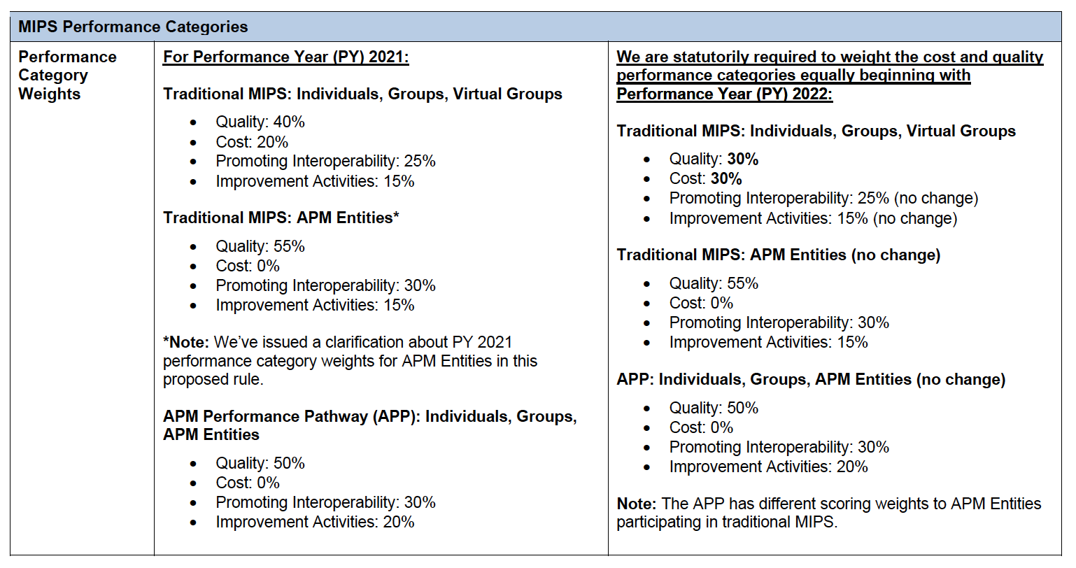
MIPS Performance Categories
Notes:
Image pulled from the CMS Changes to QPP Policies as Finalized in the CY 2022 Physician Fee Schedule (PFS) Final Rule

Slide 39
MIPS Value Pathways (MVPs)
Beginning with the 2022 performance year/2024 payment year:
MVPs must include at least one outcome measure that’s relevant to the MVP topic
Each MVP that’s applicable to more than one clinician specialty should include at least one outcome measure that’s relevant to each clinician specialty included
When outcome measures aren’t available, each MVP must include at least one high-priority measure that’s relevant to the MVP topic
Each MVP that is applicable to more than one clinician specialty must include at least one high priority measure that is relevant to each clinician specialty included, if an outcome measure is not available

Slide 40
MVP Changes for PY 2022
Allow the inclusion of outcomes-based administrative claims measures within the quality component of an MVP
To be included in an MVP, a qualified clinical data registry (QCDR) measure must be fully tested at the clinician level
In order to determine whether a QCDR measure may be finalized within an MVP, we • will need to receive QCDR measure testing data for review by the end of the self-nomination period, that is no later than September 1 of the year prior to the applicable performance period.
CMS will begin transitioning to MVPs in the 2023 MIPS performance year

Slide 41
The Future of MVPs
For the 2023, 2024, and 2025 performance years, MVP Participants are identified as individual clinicians, single specialty groups, multispecialty groups, subgroups, and APM entities that are assessed on an MVP for all MIPS performance categories. Beginning in the 2026 performance year, multispecialty groups will be required to form subgroups in order to report MVPs.
To report an MVP, an MVP Participant and subgroup must register for the MVP between April 1 and November 30 of the performance year
To report the Consumer Assessment of Healthcare Providers and Systems (CAHPS) for MIPS Survey associated with an MVP, a group, subgroup, or APM Entity must complete their MVP registration by June 30 of the performance year to align with the CAHPS for MIPS Survey registration deadline.

Slide 42
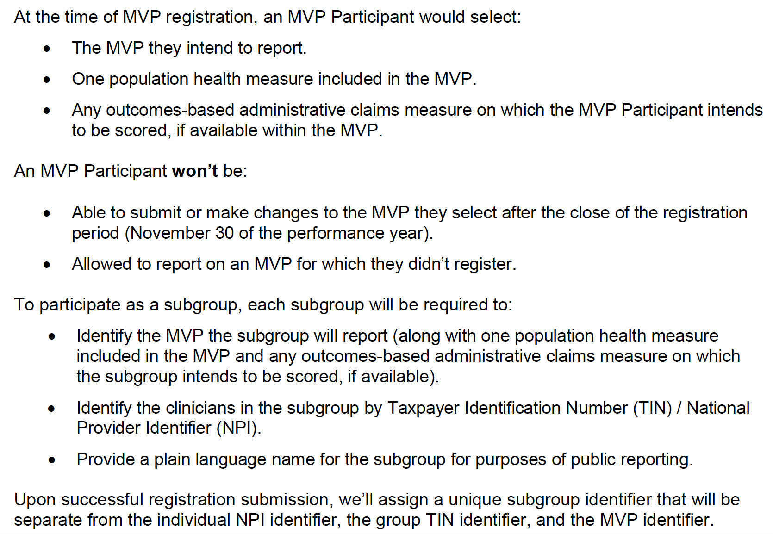
MVP Registration Instructions
Notes:
image provided from the CMS Calendar Year (CY) 2022 Physician Fee Schedule Final Rule: Quality Payment Program (QPP) Policies Overview

Slide 43
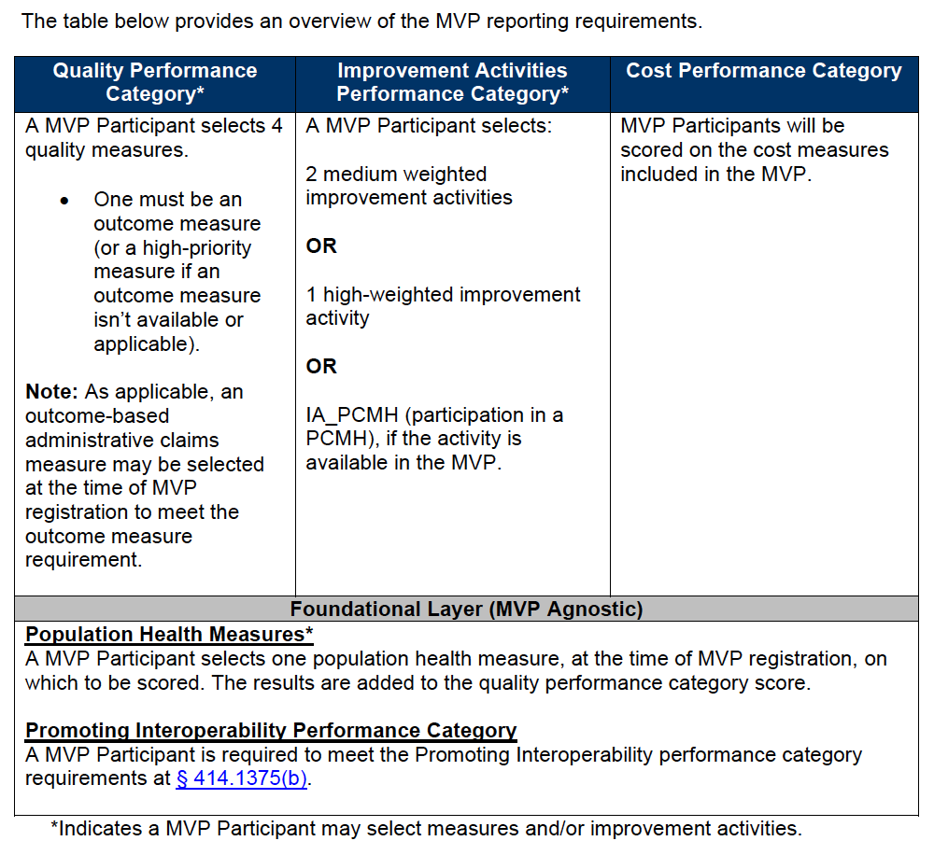
MVP Reporting Requirement
Notes:
image provided from the CMS Calendar Year (CY) 2022 Physician Fee Schedule Final Rule: Quality Payment Program (QPP) Policies Overview

Slide 44
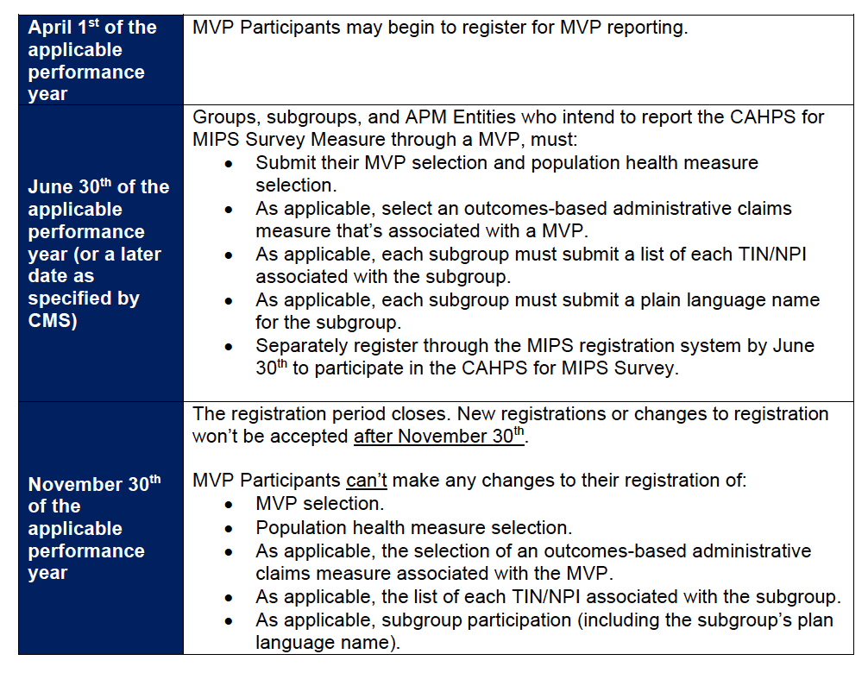
MVP Timeline
Notes:
image provided from the CMS Calendar Year (CY) 2022 Physician Fee Schedule Final Rule: Quality Payment Program (QPP) Policies Overview

Slide 45
STARK Law Changes
Value-based exception: permits physicians and other healthcare providers to design and enter into value-based arrangements without fear that legitimate activities to coordinate and improve the quality of care for patients and lower costs would violate the Stark Law.
The exceptions apply regardless of whether the arrangement relates to care furnished to people with Medicare or other patients.
These finalized exceptions provide new flexibility for certain arrangements, such as donations of cybersecurity technology that safeguard the integrity of the healthcare ecosystem, regardless of whether the parties operate in a fee-for-service or value-based payment system.

Slide 46
Provider Enrollment Changes
Exempts independent diagnostic testing facilities (IDTF) that only perform services that do not require direct or in-person beneficiary interaction, treatment, or testing from several IDTF supplier standards
Expands CMS’ authority to deny or revoke a provider’s or supplier’s Medicare enrollment
CMS may revoke a provider’s enrollment if the provider, supplier, or owner, managing employee, medical director, supervising physician, or other healthcare personnel has been excluded from participating in the Medicare program by OIG. CMS expanded this authority to deny enrollment to include administrative or management personnel including billing specialists, accountants, or human resources specialists as well
Establishes specific rebuttal procedures in regulation for providers and suppliers whose Medicare billing privileges have been deactivated

Slide 47
Opioid Treatment Program (OTP) Changes
CMS finalized a policy to allow OTPs to furnish counseling and therapy services via audio-only after the conclusion of the PHE provided all other requirements are met
This will require the use of a service-level modifier
CMS also finalized an interim final rule to maintain the payment amount for methadone at the CY 2021 rate throughout CY 2022

Slide 48
Electronic Prescribing for Controlled Substances (EPCS)
Eff Jan 1, 2022, exceptions to the EPCS mandate will include:
When the pharmacy and prescriber are the same entity
When the prescriber issues <100 controlled substance prescriptions for Part D drugs per calendar year and
The prescriber is in the geographic area of an emergency or disaster declared by a federal or state entity or
The prescriber was granted a CMS-approved waiver based on extraordinary circumstances
Additionally, the enforcement date for EPCS compliance actions has been delayed to 1/1/2023 (1/1/2025 for long-term care facilities)

Slide 49
Surprise Billing

Slide 50
What is the No Surprises Act
This new rule provides protections for patient which regulate the balance billing process and create new ways for patients to understand their financial responsibilities.
This act went into effect on January 1, 2022.
HHS defines surprise medical billing, or balance billing, as follows:
“When patients receive care from out-of-network providers or facilities and the service costs are not fully covered by the patient’s insurance provider”

Slide 51
Compliance Components
Billing Compliance
Price Transparency
Patient Protection
This section regulates the definition of a surprise bill, which facilities/provider types it applies to, and any services that are not included under this mandate
This component defines the provider’s responsibility to provide cost information to the patient in advance, including alternative options available
Notably, if surprise medical bills (as defined by HHS) are issued to patients, the patient will be held harmless, and the facility may be at risk for violating this rule

Slide 52
Billing Compliance
By law, out-of-network providers at in-network facilities are prohibited from balance billing patients.
Additionally, ancillary providers may not balance bill. This definition of ancillary providers includes:
Physicians and non-physicians in emergency medicine, anesthesiology, pathology, radiology, laboratory, and neonatology service areas. It also includes items and services provided by assistant surgeons, hospitalists and intensivists.

Slide 53
Billing Compliance
Non-ancillary OON providers at in-network facilities may provide notice and consent of the intention to balance bill when certain conditions are met:
The patient has been notified the care is out-of-network
The patient has been given other in-network options at that facility
The patient has received the estimated cost of care
The patient has opted to continue with the OON provider

Slide 54
Payment Disputes
For services that cannot be balanced billed, final payment will be determined between the health plans and the providers. Disputes will be handled through their new “independent dispute resolution (IDR)” process if there isn’t a state law or an all-payer model (Maryland) to determine the payment amount directly.
State laws would preempt the federal IDR process in states where laws:
Include a method for determining total OON amount for a plan
Apply to the plan or issuer
Apply to the OON provider
Apply to the item or service
They must include:
How the OON payment rate and dispute process will be handled
How the recognized amount is calculated to determine patient cost-sharing

Slide 55
ERISA & No Surprises Act
Self-Plans are not generally regulated by the state, and this did not change with the No Surprises Act
HHS recognized that under ERISA, the federal requirements related to balance billing would generally apply to all self-funded plans, however:
HHS created an exception in states where self-funded plans can opt-in and comply with state processes
In states with the above exceptions self-funded plans can voluntarily opt-in to state laws that provide for a method of determining cost sharing
Provided by MGMA

Slide 56
IDR Process
Provider receives notice of payment amount or denial
Either party then has 30 days to initiate the IDR
This begins a 30-day negotiation period where the provider and plan attempt to find agreement on their own
After that period is exhausted the formal IDR process may be initiated within 4 days
Once the formal IDR process starts, the parties have 3 days to select an arbiter (this must be a federally certified arbiter who has no conflicts)
Within 10 days of selecting the federal IDR arbiter, each party must submit their offers and supporting documentation
The arbiter is required to make a final payment determination within 30 days of being selected to arbitrate

Slide 57
IDR Timeline
Day 1 begins with the receipt of payment or denial notice from the payer.
Day 64
Deadline to initiate formal IDR Process
Day 77
Deadline to submit offers and documentation
Window to initiate IDR
First 30 Days
31-60 Days
61-90 Days
91-120 Days
Window to negotiate with payer. This 30-day period must be met in full.
Day 107
Deadline for arbiter to make final determination
Day 67
Deadline to select a federal arbiter and submit processing fees
This timeline assumes all windows and timelines take the exact amount given to complete.

Slide 58
IDR Process Fees
In order to financially support the IDR process, HHS has established two fees related to IDR. For 2022 these are:
Administrative fee $50.00 (non-refundable)
IDR Entity Processing Fee $200-$500 (returned to the prevailing party)
These fees are by determination
The IDR Fee will be returned to the entity whose offer is selected by the arbiter
If the arbiter determines that the IDR not applicable (i.e. the provider/service was not subject to the surprise billing ban) then the two parties will split the entity processing fee.

Slide 59
IDR Payment Understanding
The median contracted rate recognized by the plan on 1/31/19 for a same/similar service in the same geographic region, with an inflation adjustment will serve as the qualifying payment amount (QPA) for the arbiter
The arbiter will use the QPA to determine cost-sharing amounts for out-of-network care and the assumed OON rate during their arbitration process
The arbiter is not responsible for determining the appropriateness of the QPA

Slide 60
IDR Payment Understanding
The IDR has been directed to select the offer that is closest to the QPA unless the IDR believes the QPA to be materially different from the appropriate OON amount
This would only happen where substantial documentation was submitted in support by the provider
IDR will include market concentration in their analysis
IDR may not consider public payer rates (Medicare/Medicaid) to determine payment amount

Slide 61
What is Transparency
This means giving patients all the information they need to make an informed decision on out-of-network care so that they can avoid large surprise bills
The goals are to improve patient’s understanding of:
The total cost of care
Provider networks
Insurance plan cost sharing

Slide 62
Good Faith Estimates (GFE)
Good faith estimates apply to:
All uninsured patients
Insured patients who do not plan to submit claims to insurance
Self-pay patients
Effective 1/1/22, the GFE must be provided to these patients

Slide 63
What is the GFE
This is a document to be provided to patients which identifies (1) the cash price for services (2) less any discounts and (3) reflects the total cost of care by the provider for that period of care.
In this definition, period of care means the day or multiple days in which the primary service is performed and other additional services that would likely be done alongside the primary item or service.

Slide 64
GFE: Who & When
Who. The requirement to provide a GFE applies to all physicians or other healthcare providers who act within the scope of practice of that provider’s license or certification.
Per CMS: These requirements don’t apply to people with coverage through programs like Medicare, Medicaid, Indian Health Services, Veterans Affairs Health Care, or TRICARE. These programs have other protections against high medical bills.
When. The GFE must be provided to a patient when they request or when the service is scheduled.
If the service is scheduled more than 10 days in advance, the provider must provide the FTE within 3 business days.
If the item/service is scheduled within 3 business days in advance, the GFE must be provided within 1 business day

Slide 65
GFE: What to Include
Patient’s name and Date of Birth
Date of scheduled services
Name, NPI, and TIN of provider, states and facility location of care
Total Cost of Care for the period of care
Itemized list and description of expected services with service codes
Itemized list of related diagnosis codes and descriptions
All associated and anticipated charges
Disclaimer that there may be additional services which would be scheduled separately that are not reflected
Disclaimer that this information is only an estimate
Disclaimer that informs patient about their right to initiate a dispute resolution process
Disclaimer that the GFE is not a contract
It should not exceed a scope of 12 months
*Note: If a patient requests a GFE prior to scheduling, the GFE must be given to the patient again once scheduled

Slide 66
GFE: Multiple Providers
Convening Provider: This is the term used for the provider who initially schedules the patient and provides the “primary service”
Co-Providers: these are auxiliary providers that support the period of care but did not initially schedule and perform the primary service
In 2022, HHS will not require the convening provider to obtain GFEs from co-providers, however, the rule is written to include this as a requirement going forward

Slide 67
Patient Dispute Resolution
If the GFE provided to the patient is exceeded by a substantial amount, the patient has the right by law to seek resolution:
This Act defines a substantial amount as $400 or more
Notably, this threshold remains the same regardless if additional unforeseen services were added to the plan of care after the GFE was provided.
HHS will choose up to there Selected Dispute Resolution Entities (SDREs) in 2022 to resolve claims between patients and providers
They will establish a portal online for patients to submit disputes with an administrative processing fee of $25

Slide 68
Resources

Slide 69
CMS Provider Toolkit
A link to this is in the resources slide at the end and includes:
Right to receive a GFE of Expected Charges Notice (to post)
GFE Template
SDRE Declining Eligibility or Need More Information Notice
PPDR – Dispute Initiation Form
HHS – Appendix SDR Entity Certification Data Elements
HHS – Appendix Vendor Management (VM) Data Elements
HHS – Appendix PPDR Data Elements for Patients and Providers
PPDR – SDRE Determination Notice
PPDR – SDRE Selection Notice
PPDR – Payment Settlement Form
HHS – Appendix – Good Faith Estimate Data Elements
HHS – PRA Supporting Statement

Slide 70
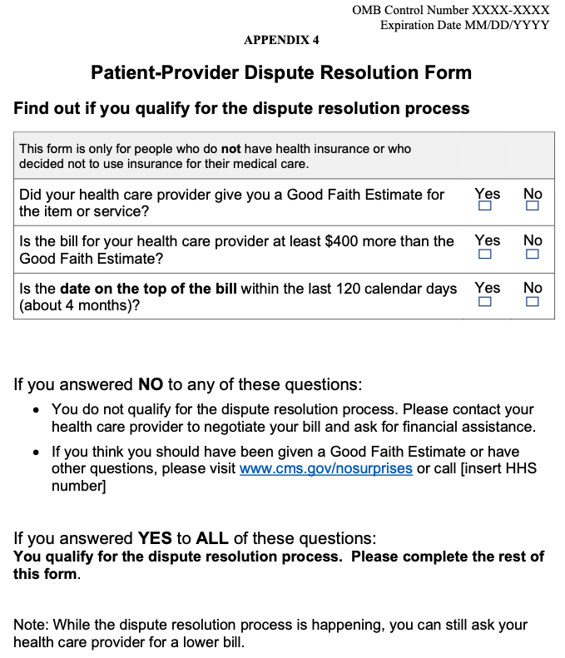
Patient Provider Dispute Resolution Form
This 5-page form is what the patient would complete to initiate a dispute. The first three questions are qualifier questions. A “no” for any of these will require them to reach out directly to CMS for more information or to the provider to negotiate the bill.

Slide 71
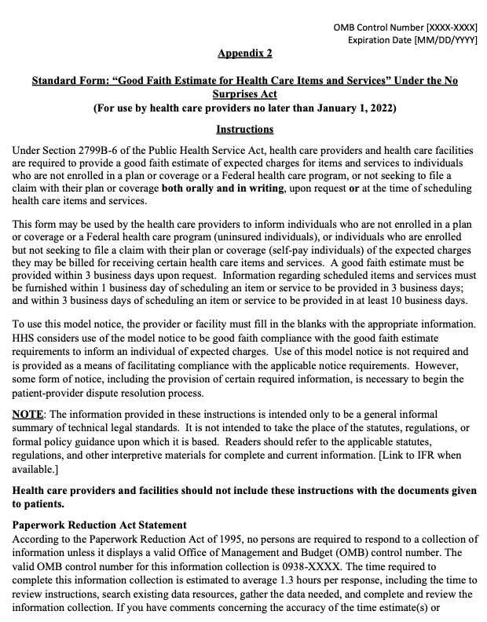
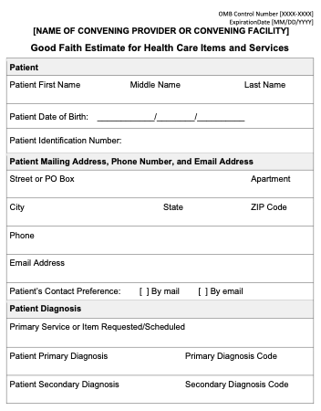
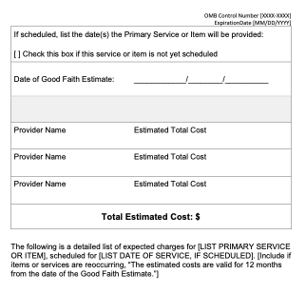
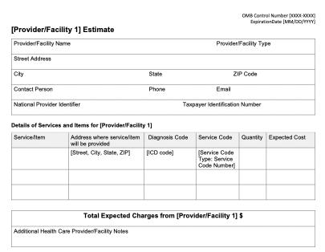
GFE Template
This ten-page document includes the information and form template required to begin the GFE process right away. There have templated out sections for three providers/facilities to start and providers can add on to that as needed.
Download this toolkit and educate staff right away to ensure compliance.

Slide 72
OIG Workplan

Slide 73
OIG Workplan
OIG updates their workplan monthly
Completed items remain in the OIG workplan for one-month post-completion
The top priorities for 2022, per OIG, include:
Safeguarding public health
Ensuring the financial integrity of HHS programs
Delivering Value, Quality, and Improved Outcomes in Medicare and Medicaid
Protecting the Health and Safety of HHS Beneficiaries
Harnessing Data To Improve Health and Well-Being of Individuals
Improving Collaboration To Better Serve Our Nation
https://oig.hhs.gov/reports-and-publications/workplan/index.asp

Slide 74
Recently Added to OIG Workplan
Nursing Home Reporting of COVID-19 Data to the National Healthcare Safety Network
Toolkit for Identifying Adverse Events Through Medical Record Review
Adverse Events: Disparities Among Hospitalized Medicare Patients
OIG Oversight of State Medicaid Fraud Control Units
Comparison of Average Sales Prices and Average Manufacturer Prices
Audit of IHS Telehealth Technologies' Cybersecurity Controls

Slide 75
HIPAA’s Right to Access & OCR Settlements Related to the Right to Access Initiative

Slide 76
Right of Access Initiative
Announced in 2019, this initiative evidences OCRs determination to ensure patient’s timely access to their records
HIPAA regulations require that:
“an individual has a right of access to inspect and obtain a copy of protected health information about the individual in a designated record set, for as long as the protected health information is maintained in the designated record set, except for: (i) psychotherapy notes; and (ii) information compiled in reasonable anticipation of, or for use in, a civil, criminal, or administrative action or proceeding.”

Slide 77
Access & Fees
Access to the requested information should be provided within 30 days of receiving the request for access, unless there is a specific reason why it cannot be provided so quickly
If there is a need to extend beyond 30 days:
Facility must provide a written explanation to the patient about the reason for the delay
The request must be fulfilled within 60 days of the initial request with only one extension being allowed per request
Facilities may charge a small, reasonable fee for providing a copy of PHI
It may only be a fee to cover the cost of creating the copied record
This fee is not allowed to include any other associated costs, even if other costs appear to be authorized by state law

Slide 78
Settlements for Violations
OCR has completed twenty investigations into allegations of access violations:
2019 – two settlements for $85,000 each
2020 – eleven settlements ranging from $3,500 to $160,000
2021 – seven settlements ranging from $5,000 to $200,000
All twenty investigations have found misconduct and have had a fine assessed.

Slide 79
Ensure Compliance
Evaluate existing workflows/processes related to patient information requests
Ensure that patient requests are being met in full
Flag additional patient requests to determine what was missed in the initial release of information to continuously improve records release efforts
If a 3rd party is being used to handle records release perform due diligence and regular oversight to ensure compliance; ultimately the facility is responsible to ensure the patients right to access

Slide 80
Emergency Temporary Standard (ETS)

Slide 81
ETS Update
In November, the U.S. Court of Appeals for the Fifth Circuit granted a motion to stay OSHA's COVID-19 Vaccination and Testing Emergency Temporary Standard, published on November 5, 2021 ("ETS"). The court ordered that OSHA "take no steps to implement or enforce" the ETS "until further court order."
OSHA has extended the comment period through January 19, 2022.
Recently, The U. S. Court of Appeals for the Sixth Circuit dissolved the stay issued by the Fifth Circuit.
January 13, 2022, Supreme Court Ruling blocked the “Vaccine or Test” mandate. There is a “stay” on the enforcement of the entire ETS and it will not be enforced by OSHA.
Notes:
The sticking point has been the “vaccinate or test mandate” to enter the workplace for large employers of the ETS
It was first blocked in November 2021 by a Federal Appeals Court
It was blocked again on Thursday, 1/13/22 by the Supreme Court
The Supreme Court’s decision was related to limiting OSHA’s power to regulate broad public health
Would have impacted “large employers”
There is still trial court level litigation happening so stay tuned
https://www.osha.gov/coronavirus/ets2

Slide 82
OSHA Emergency Temporary Standard (ETS)
Employees working in health care settings where suspected or confirmed coronavirus patients are treated are covered under ETS. Private employers with 100 or more employees firm- or corporate-wide.
In states with OSHA-approved State Plans, state and local-government employers, as well as private employers, with 100 or more employees will be covered by state occupational safety and health requirements.
Employers Include:
Hospitals
Nursing Homes
Assisted Living Facilities
Emergency Responders
Home Health
Ambulatory Care Settings
Public sector state and local government workers, including educators and school staff
- -

Slide 83
OSHA ETS Resources
ETS Regulatory Text (29 CFR 1910, Subpart U)
1910.501 - Vaccination, Testing, and Face Coverings
1910.504 - Mini Respiratory Protection Program
1910.505 - Severability
1910.509 - Incorporation by Reference
Federal Register (PDF)
Ratification Document (PDF)
FAQs
Social Media Toolkit (Spanish)
Materials Incorporated by Reference
News Release
Webinar / Slides (PDF) (Spanish)
Fact Sheets
About the ETS
ETS Summary
How You Can Provide Comments (Spanish)
https://www.osha.gov/coronavirus/ets2

Slide 84
CMS Vaccine Mandate FAQs
https://www.cms.gov/files/document/cms-omnibus-covid-19-health-care-staff-vaccination-requirements-2021.pdf
Q: What about Assisted Living Facilities, Group Homes, or other similar settings?
A: “This regulation only applies to Medicare and Medicaid-certified facilities. CMS does not have regulatory authority over care settings such as Assisted Living Facilities or group homes. This regulation will also not apply to physician’s offices because they are not subject to CMS health and safety regulations.”
Notes:
Please don’t log off now (LOL)

Slide 85
What About Medical Facilities?
Supreme Court allowed the vaccine mandate for some medical facilities that are Medicare or Medicaid CERTIFIED
Facilities that are subject to CMS health and safety regulations
Notes:
CMS has a vaccine mandate for many healthcare providers
This mandate was upheld by the Supreme court

Slide 86
CMS Vaccine Mandate
CMS issued the vaccination mandate on the same date that OSHA issued the ETS (11/4/21)
Does not allow for testing instead of vaccination protocol
Has a phased compliance timeline and approach
Applies to some not all healthcare facilities
Notes:
This mandate was upheld by the Supreme court
CMS has a vaccine mandate for many healthcare providers

Slide 87
Who must comply with CMS Vaccine Mandate?
Answer: The staff vaccination requirement applies to the following Medicare and Medicaid-certified provider and supplier types:
Ambulatory Surgery Centers,
Community Mental Health Centers,
Comprehensive Outpatient Rehabilitation Facilities,
Critical Access Hospitals,
End-Stage Renal Disease Facilities,
Home Health Agencies,
Home Infusion Therapy Suppliers,
Hospices,
Hospitals,
Intermediate Care Facilities for Individuals with Intellectual Disabilities,
Rehabilitation Agencies,
Public Health Agencies as Providers of Outpatient Physical Therapy and Speech-Language Pathology Services,
Clinics,
Psychiatric Residential Treatment Facilities (PRTFs)
Programs for All-Inclusive Care for the Elderly Organizations (PACE), Rural Health Clinics/Medicare Federally Qualified Health Centers,
Long Term Care facilities

Slide 88
CMS Vaccine Mandate FAQs
Q: Does this requirement apply to full time teleworkers?
A: No. Individuals who provide services 100% percent remotely and who do not have any direct contact with patients and other staff, such as fully remote telehealth or payroll services, are not subject to the vaccination requirements outlined in this regulation.

Slide 89
CMS Vaccine Mandate FAQs
Q: Would a physician with admitting privileges in a hospital be covered under this requirement?
A: Yes, a physician admitting and/or treating patients in-person within a facility subject to the CMS health and safety regulations and included as a part of this requirement must be vaccinated so that the facility is compliant.

Slide 90
CMS Vaccine Mandate FAQs
Q: Are staff who work in Assisted Living Facilities required to be vaccinated if they also work in a nursing home?
A: Yes. While Assisted Living Facilities (ALFs) are not regulated by CMS and not directly subject to the Medicare Conditions of Participation, individuals who move between facilities (e.g. ALFs and nursing homes) and provide care, treatment, or other services for the certified nursing home and/or its residents under contract or arrangement must be vaccinated.

Slide 91
CMS Vaccine Mandate FAQs
Q: Does this requirement apply to schools receiving Medicaid funding?
A: No, this regulation only applies to those Medicare and Medicaid-certified provider and supplier types that are regulated under CMS health and safety regulations. CMS does not regulate schools.

Slide 92
CMS Vaccine Mandate FAQs
Q: Does this requirement apply to visitors?
A: Facilities are required to have a process or policy in place ensuring that all applicable staff are vaccinated against COVID-19. This requirement does not apply to personal visitors such as family members or friends; however, it does apply to contractors that visit the facility on a regular basis. CMS strongly encourages all individuals and families to get vaccinated now.

Slide 93
Important Timelines
OSHA ETS
1/10/22 – Masking requirement [BLOCKED]
2/9/22 – Vaccine requirement [BLOCKED]
CMS Vaccine Mandate – Phase II
2/28/22
P & P for ensuring vaccinations or exemptions
100% of workforce is fully vaccinated or exempted
3/28/22 – Notice of delay and more than 90% of
workforce is vaccinated
Notes:
Boosters are not being taken into consideration for qualifying as fully vaccinated
CMS has noted that it has a variety of enforcement mechanisms available from issuance of civil monetary penalties and denial of payments for new admissions to termination of participation from the Medicare and Medicaid programs. CMS has stated that its goal is for all Medicare and Medicaid health care facilities to be in compliance with the CMS Vaccine Mandate, and termination would only be implemented as a last resort after giving the provider the opportunity to make corrections and come into compliance.

Slide 94
References & Links
CMS “No Surprises” www.cms.gov/nosurprises
AMA “Summary of Interim Final Rule (Part 2)”
MGMA “Implementing the No Surprises Act”
CMS’ list of certified IDR Entities
OSHA ETS information
CMS Provider Toolkit
OIG – List of Excluded Individuals/Entities
RCM Book – www.mgma.com/rcm
RevDive Podcast – http://sliceofhealthcare.com/revdive/

Slide 95
Thank You!
If you have questions or want to
stay in touch, please reach out!
Taya Moheiser
Taya@ITSHealthcareConsulting.com
@TayaMoheiser
Linkedin.com/in/TayaMoheiser

